Slide 1
MULTI OPERATIONAL VEHICLE FOR AGRICULTURAL APPLICATION

Slide 2
ABSTRACT
India is an agriculture based country in which, 70% of people depends on the outcome of farming. But if we observe that with increase in population the farm gets distributed among the family and because of this, farmer in India held averagely only two acre farm. Also economically, farmers are very poor due to which they are unable to purchase tractors and other costly equipment hence they use traditional method of farming. Basically, many farmers in India also use bullocks, horses and he-buffalo for farming operation. This will not satisfy need of energy requirement of the farming as compared to other countries in the world. So we are thinking that human and animal efforts can be replaced by some advance mechanization which will be suitable for small scale farmer from economical and effort point of view. So we are developing this equipment which will satisfy all this need and to solve labour problem. In this equipment we used ploughing rod, water pump and seed sower attachment. This machine perform three farming operation (ploughing, sowing, water spraying) which is used small scale farming. By using above attachments one may perform various farming operations in less time and economically.

Slide 3
INTRODUCTION
Agriculture has been the backbone of the Indian economy and it will continue to remain so for a long time. It has to support almost 17 percent of world population from 2.3 percent of world geographical area and 4.2 percent of world’s water resources. The present cropping intensity of 137 percent has registered an increase of only 26 percent since 1950-51. The net sown area is 142 Million hectare. The basic objective of sowing operation is to put the seed and fertilizer in rows at desired depth and spacing, cover the seeds with soil and provide proper compaction over the seed. The recommended row to row spacing, seed rate, seed to seed spacing and depth of seed placement vary from crop to crop and for different agricultural and climatic conditions to achieve optimum yields and an efficient sowing machine should attempt to fulfil these requirements. In addition, saving in cost of operation time, labour and energy are other advantages to be derived from use of improved machinery for such operations. A traditional method of seed sowing has many disadvantages. This paper is about performing different agricultural operations with the help of single vehicle setup which can perform simultaneous operations

Slide 4
CONSTRUCTION
The base frame for mounting overall setup is fabricated with the help of square tubes and channels with the help of metal cutting and metal joining process called welding. Wheels are mounted to the frame for its displacement, ploughing rod attachment is mounted at its front end portion of the frame whose depth of ploughing is controlled by means of lead screw mechanism. Front end wheel shaft is coupled to the disc plate which is connected to the activating lever of the reciprocating pump, whose outlet is connected to multi opening for covering large workspace. On the rear end shaft seed sprinkling attachment is placed which has the loading hopper which houses the seed to be dipped and it gets sprinkled by metring plate which is powered by means of manual drive

Slide 5
LITERATURE REVIEW1/4
Patil Nikhil V , ShaikhAjaharuddin G , Gaykawad Ratanlalsingh D , Deore Ganesh S , Chaure Ganesh ,Prof. P.G.Tathe
Multipurpose Agriculture Vehicle
As we know agriculture is the backbone of India. Rice and Wheat is one of the new targets in agriculture where still, less researchers and manufacturers participate. This field faces some problems such as how to minimize the losses, how to increase productivity and how to minimize cost. In India, two types of agricultural methods are used, manual method (conventional method) and mechanize type method. Mechanization involves the use of a hybrid device between the power source and the work. This hybrid device usually transfers motion, such as rotary to linear, or provides ample of mechanical advantages such as increase or decrease or leverage of velocity. Agricultural machinery is machinery used in farming or other agriculture. Mechanized agriculture is a process of using agricultural machinery to mechanize the work of agriculture, greatly increasing farm worker productivity. In this modern era, automatedagro machinery has replaced many farm jobs that are carried out by labour or by animals such as oxen, horses etc.. The entire history of agriculture contains many examples of the use of tools, such as the hoe and the plough. The benefit of agro automation is that it saves the labour cost. However, it also saves the energy and cost of materials and to improve the quality, accuracy, and nicety. The seed feeding, pesticides sprinkling and crop cutting are the important stages in the agriculture field. The design of multipurpose agro equipment machine will help Indian farmers in rural side and small farm. It will reduce the cost of seed feeding, pesticides sprinkling and crop cutting the field and will help to increase economic standard of an Indian farmer

Slide 6
LITERATURE REVIEW2/4
Swetabh , Manish Kashyap , Yash Yadav , Ashutosh Singh Dhruv Kuma
MULTI-TASKING AGRICULTURAL MACHINE TOOL
The paper proposed with multi-purpose agriculture machine tool for spraying pesticides, fertilizers, water, pluging and cutting purpose. Thus paving way for a more economical and multi-usable equipment for farmer which is also easy to clean and maintain, easy to handle and do not require fuel, hence cost gets reduced and helping farmers to a great extent in their fields

Slide 7
LITERATURE REVIEW3/4
Dr. C.N.SAKHALE
MULTIPURPOSE FARM MACHINE”
India is an agriculture based country in which, 70% of people depends on the outcome of farming. But if we observe that with increase in population the farm gets distributed among the family and because of this, farmer in India held averagely only two acre farm. Also economically, farmers are very poor due to which they are unable to purchase tractors and other costly equipments hence they use traditional method of farming. Basically, many farmers in India also use bullocks, horses and he-buffalo for farming operation. This will not satisfy need of energy requirement of the farming as compared to other countries in the world. So We are thinking that human and animal efforts can be replaced by some advance mechanization which will be suitable for small scale farmer from economical and effort point of view. So we are developing this equipment which will satisfy all this need and to solve labour problem. In this equipment We used 24cc engine for digging operation. And for spraying used motor with 12V battery. Next two operations are manual base which is cultivation and sowing . This machine perform four farming operation (digging, sowing, cultivation, spraying) which is used small scale farming .By using above attachments one may perform various farming operations in less time and economically.

Slide 8
LITERATURE REVIEW4/4
heikh Mohd Shahid Mohd Sadik , H.A. Hussain
Design and Fabrication of Multipurpose Farming Machine
Agriculture being one of the major occupation in India, Agriculture plays a vital role in the Indian economy. Indian agriculture has registered impressive growth over last few decades. It is very essential to discover and implement new idea in this field, though lot of work has been done in this area. It is unfortunate that, these ideas are not being implemented properly in actual field. This is due to high cost and is complicated for rural people. Multipurpose agriculture or farming machine is basic and major machine involved in agriculture for maximum yielding. The Conventional method of ploughing and seed sowing is a laborious process and hence for that reason there is a scarcity of labours and Basically, many farmers in India also use bullocks, horses and he-buffalo for farming operation. This will not satisfy need of energy requirement of the farming as compared to other countries in the world. This result in delayed agriculture crop production practices to overcome these difficulties, I am thinking that human and animal efforts can be replaced by some advance mechanization which will be suitable for small scale farmer from economical and effort point of view. So, I developing this machine which will satisfy all this need and to solve labour problem. A multipurpose farming machine is designed.

Slide 9
WORKING PRINCIPLE
When the frame gets displaced on the field by adjusting the ploughing rod according the ploughing depth, soil ploughing operation is performed. During its activation the front and rear wheels gets rotated, the rotation of front wheel is transferred to the activating lever of the reciprocating pump by the eccentric connection of disc plate. Due to this water from the reservoir is collected and discharged at the multi pass outlet pipe for performing water spraying operation. Similarly on the rear end, metring plate carries the seed loaded in the hopper and discharge at the ploughed field by the rotation experienced at the rear wheel mounted shaft.

Slide 10
MAJOR COMPONENTS MAJOR COMPONENTS
LEAD SCREW
BLOWER
RECIPROCATING PUMP
WHEEL
DISC
CHAIN DRIVE
SEED SOWER
FRAME
BEARING
SHAFT
METAL STRIP
SHEET METAL

Slide 11
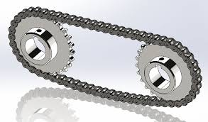
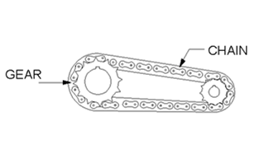
CHAIN DRIVE
Chain drive is a way of transmitting mechanical power from one place to another. It is often used to convey power to the wheels of a vehicle, particularly bicycles and motorcycles.
he power is conveyed by a roller chain, known as the drive chain, passing over a sprocket gear, with the teeth of the gear meshing with the holes in the links of the chain. The gear is turned, and this pulls the chain putting mechanical force

Slide 12
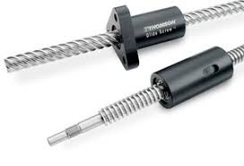
LEAD SCREW
Material: Mild steel
Diameter: 15mm

Slide 13
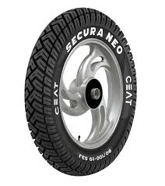
WHEEL
Hub material: steel
Tire: Rubber

Slide 14
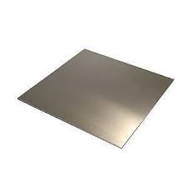
SHEET METAL
Sheet metal is used to make the collecting box.
Material - Mild steel
Size - 40*15cm
Thickness - 3mm
Quantity - 1

Slide 15
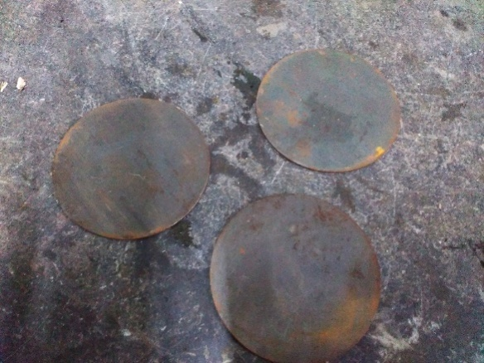
CIRCULAR DISC
Specifications:
Material: Mild steel
Outer diameter: 6 inch
Thickness: 3mm

Slide 16
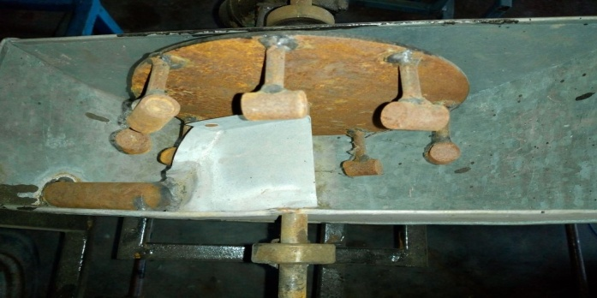
SEED SHOWER
The mechanism of a seed drill or fertilizer distributor which delivers seeds or fertilizers from the hopper at selected rates is called seed metering mechanism

Slide 17
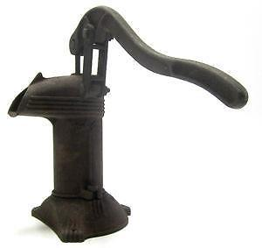
RECIPROCATING PUMP
A reciprocating pump is a class of positive-displacement pumps which includes the piston pump, plunge pump and diaphragm pump. When well maintained, reciprocating pumps will last for years or even decades; however, left untouched, they can undergo rigorous wear and tear.

Slide 18
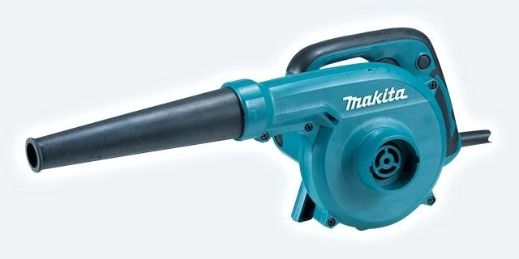
Blower
A centrifugal fan is a mechanical device for moving airor other gases in a direction at an angle to the incoming fluid. Centrifugal fans often contain a ducted housing to direct outgoing air in a specific direction or across a heat sink; such a fan is also called a blower fan, biscuit blower^{[citation needed}, or squirrel-cage fan (because it looks like a hamster wheel). These fans increase the speed and volume of an air stream with the rotating impellers

Slide 19
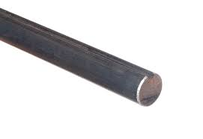
SHAFT
Shaft diameter: 12mm
Material: mild steel

Slide 20
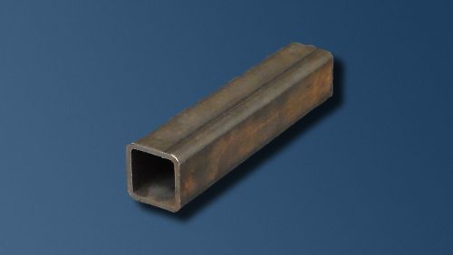
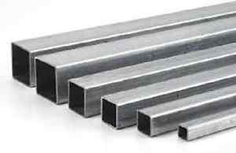
FRAME
Material: Mild steel

Slide 21
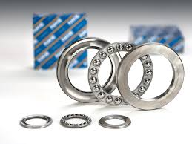
DESIGN OF BALL BEARING
Bearing No. 6202 (Data book page.no 4.13)
Outer Diameter of Bearing (D) = 37 mm
Thickness of Bearing (B) = 12 mm
Inner Diameter of the Bearing (d) = 15 mm
r₁ = Corner radii on shaft and housing
r₁ = 1(From design data book)
Maximum Speed = 14,000 rpm (From design data book)
Mean Diameter (d_{m})= (D + d) / 2
= (37 + 15) / 2
d_{m} = 26 mm

Slide 22
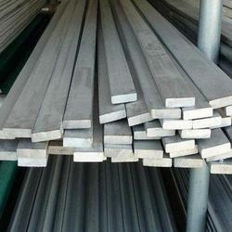
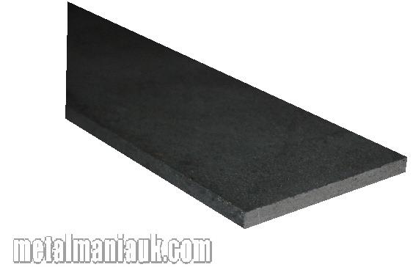
METAL STRIP
Specifications
Material: Mild Steel Strip
Length:40cm Width:5cm
Specifications
Length:60cm
Width:5cm

Slide 23
ADVANTAGES
Usage of external drives are not needed for its operation.
Pollution free handling which is also helpful for crops.
Instead of water liquid fertilizers can be sprayed.
Reduces human effort, labour charges and time consumption.
The maintenance and fabrication cost is cheap

Slide 24
APPLICATION
By varying the size of an equipment, it can be used in large and small fields.
.

Slide 25
MATERIAL USED
S.No | DESCIRPTION | QTY | MATERIAL
1. | LEAD SCREW | 1 | MILD STEEL
2. | SEED SHOWER | 1 | MILD STEEL
3.. | BEARING | 22 | STAINLESS STEEL
4. | FRAME | AS PER REQUIRMENT | MILD STEEL
5.. | SHAFT | AS PER REQUIRMENT | MILD STEEL
6. | METAL STRIP | AS PER REQUIRMENT | MILD STEEL
7. | SHEET METAL | 1 | MILD STEEL
8. | RECIPROCATING PUMP | 1 | STAINLESS STEEL
9. | WHEEL | 4 | RUBBER
10. | DISC | 1 | MILD STEEL
11. | CHAIN DRIVE | 1 | STAINLESS STEEL
12 | BLOWER | 1 | MILD STEEL
13.

Slide 26
COST ESTIMATION
S.No | DESCIRPTION | RATE
1. | LEAD SCREW | 400
2. | SEED SHOWER | 800
3.. | BEARING | 2200
4. | FRAME | 1000
5.. | SHAFT | 300
6. | METAL STRIP | 200
7. | SHEET METAL | 600
8. | RECIPROCATING PUMP | 1500
9. | WHEEL | 1600
10. | DISC | 700
11. | CHAIN DRIVE | 1200
12 | BLOWER | 500
13. | TOTAL | 11000

Slide 27
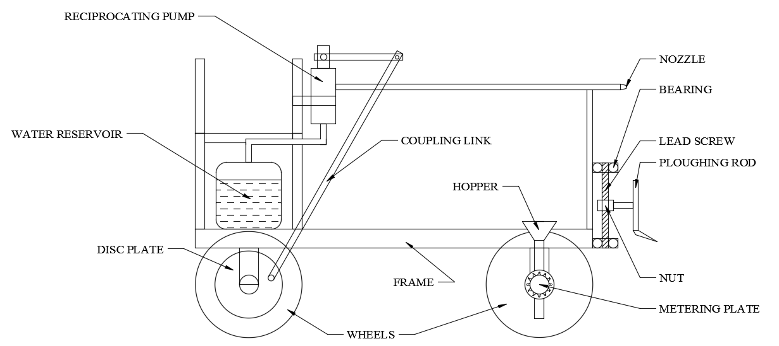
BLOCK DIAGRAM

Slide 28


